Slide 1


Social
Buzz
Accenture Data Visualization and Story Telling
Task 3

Slide 2


Today's agenda
Project recap
Problem
The Analytics team
Process
Insights
Summary

Slide 3

Social Buzz is a fast growing technology unicorn that need to adapt quickly to it’s global scale.
Accenture has begun a 3 month POC focusing on these tasks:
An audit of Social Buzz’s big data practice
Recommendations for a successful IPO
Analysis to find Social Buzz’s top 5 most popular categories of content
Project Recap

Slide 4

Problem
Over 100000 posts per day
36,500,000 pieces of content per year!
But how to capitalize on it when there is so much?
Analysis to find Social Buzz’s top 5 most popular categories of content

Slide 5



Marcus Rompton
Senior Principle
The Analytics team
Andrew Fleming
Chief Technical Architect
Thummalacharla Chandrasekhar
Data Analyst

Slide 6

Process
1
Data Understanding
2
Data Cleaning
3
Data Modeling
4
Data Analysis
5
Uncover Insight

Slide 7

Insights
16
Animal
May
Unique Categories
Most Favorite Category
With Most number of Posts

Slide 8
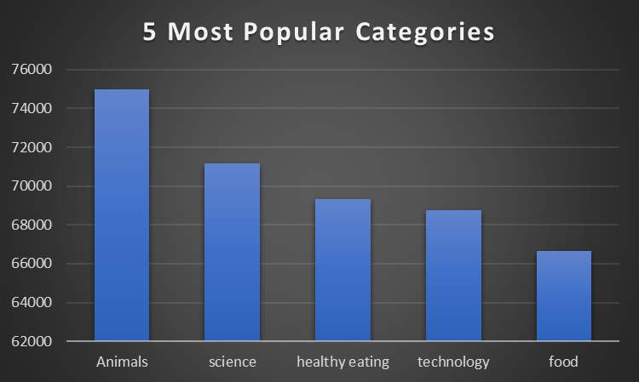
Notes:
Animals are the most popular category with over 74,000 engagements.Science comes next, slightly below animals at just under 73,000.Healthy eating ranks third with around 70,000 engagements.Technology follows closely behind healthy eating, with about 68,000.Food is the least popular category, with just over 62,000 engagements.

Slide 9
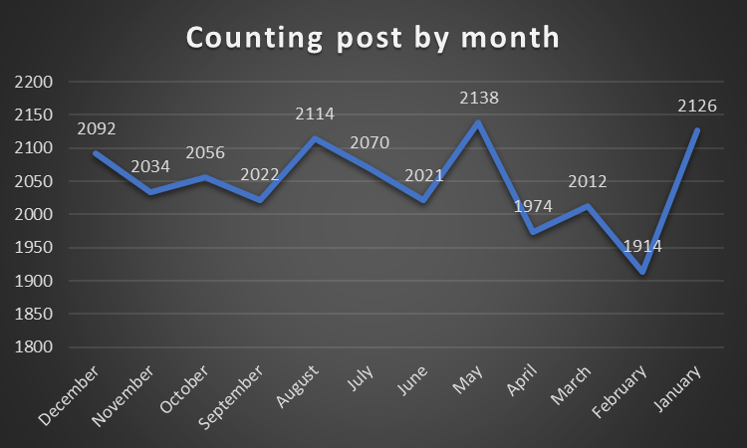
Notes:
May has the most posts, with a count of 2,138, making it the peak month.February has the fewest posts, dropping to just 1,914.There’s a noticeable rise in posts in January (2,126) and May after a dip in earlier months.The numbers gradually decline from June to February, with some ups and downs in between.Overall, the chart shows that posting activity fluctuates throughout the year, with clear highs and lows.

Slide 10
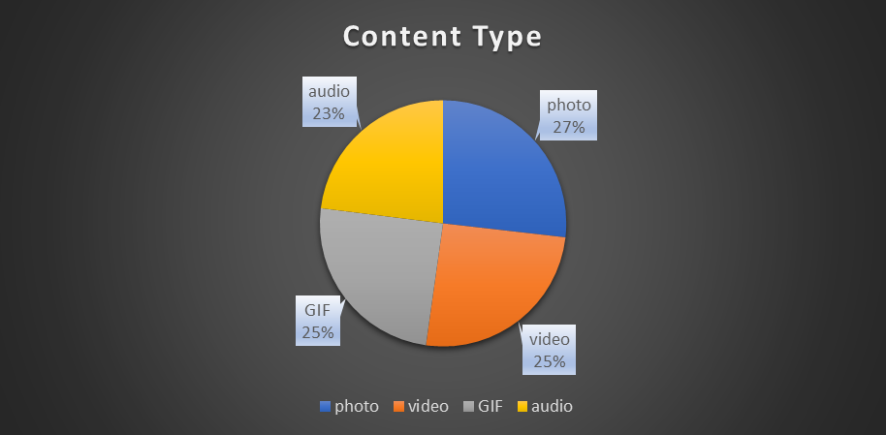
Notes:
Photos are the most common content type, making up 27% of the total.Videos and GIFs each account for 25%, showing equal importance.Audio is the least common, but still significant at 23%.The chart presents a balanced distribution of content types.It uses a dark background with labeled sections for better visibility.

Slide 11
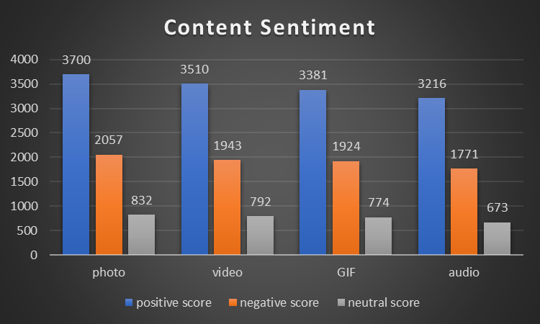
Notes:
The sentiment analysis shows that photos(6,589) have the highest positive score of 3,700, along with a negative score of 2,057 and a neutral score of 832. videos (6,589 posts) follow with a positive score 3,510, a negative score of 1,943, and a neutral score of 792. GIFs(6,079 posts) receive a positive score of 3,381,a negative score of 1,924 and a neutral score of 774. Audio content(5,660) have the highest positive score of 3,216, along with a negative score of 1,771 and a neutral score of 673.

Slide 12

Insight:
There are a total of 16 distinct content categories.
Out of which Animal and Science categories are the most popular one.
4 type of content - Photo, Video, Gif and Audio.
Out of which people prefer photo and video. May month has the highest number of posts.
Conclusion:
Should focus more on the top 5 categories that's animal, technology, science, healthy eating and food.
create campaign to specifically target those audiences.
Need to maximize in the month of January, may and august as they number of posts in these months are the highest.
Summary

Slide 13
Thank you!

